Slide 1

BY RIYAVARSHINI ARUNPRASAD
POWERED BY

Slide 2
INTRODUCTION
HR Data Analysis is the First task provided by PSYLIQ during my internship.
This project aims in demonstrating intern’s skills in using EXCEL and Visualization.
Primary objective in this project is to analyze the given HR dataset .
Entire project is performed in MS-Excel and PowerBI.

Slide 3
AGENDA
01.
DATA OVERVIEW
02.
DATA QUESTIONS
03.
DATA DASHBOARD
04.
CONCLUSION

Slide 4
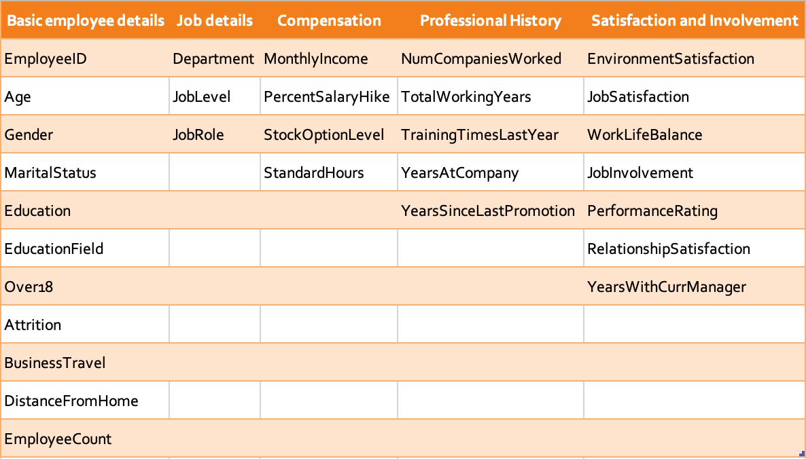
DATA OVERVIEW
Five ’.csv’ files were provided which was combined in Excel for further analysis.
The resulting dataset consist of 4410 rows and 30 columns of distinct data.
Following are the columns present in dataset:

Slide 5
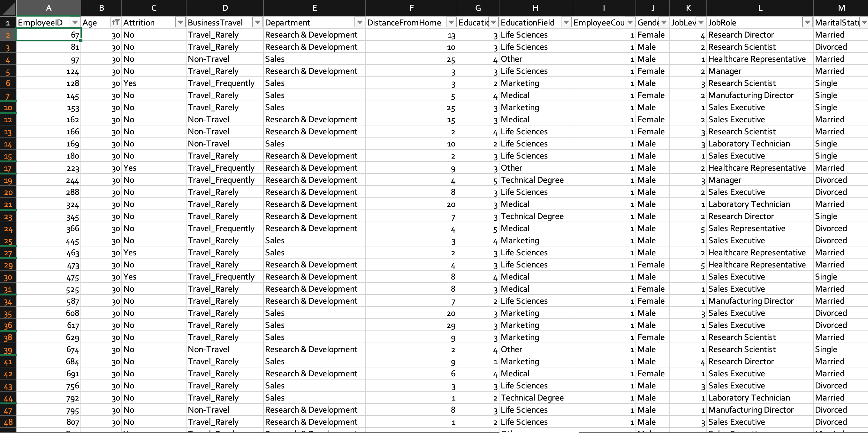
DATA QUESTIONS
1. Using Excel, how would you filter the dataset to only show employees aged 30 and above?
Select Data and choose Filter in Ribbon
Click drop-down arrow near Age column
Select drop-down list choose one
Select Greater than or equal to and enter 30 as value.
Click Apply filter

Slide 6
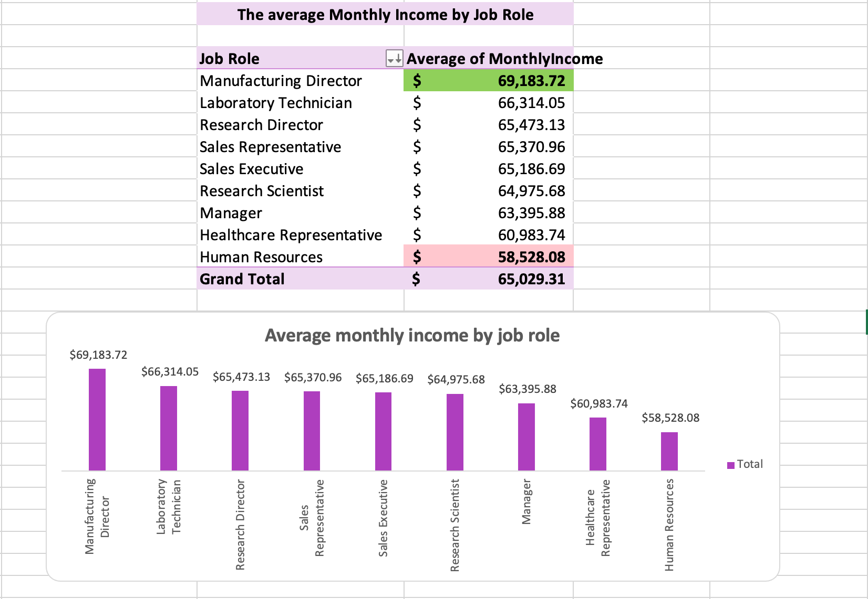
DATA QUESTIONS
2. Create a pivot table to summarize the average Monthly Income by Job Role.
Manufacturing Director founds to have highest average monthly income
Meanwhile, Human resources found to have lowest average monthly income.

Slide 7
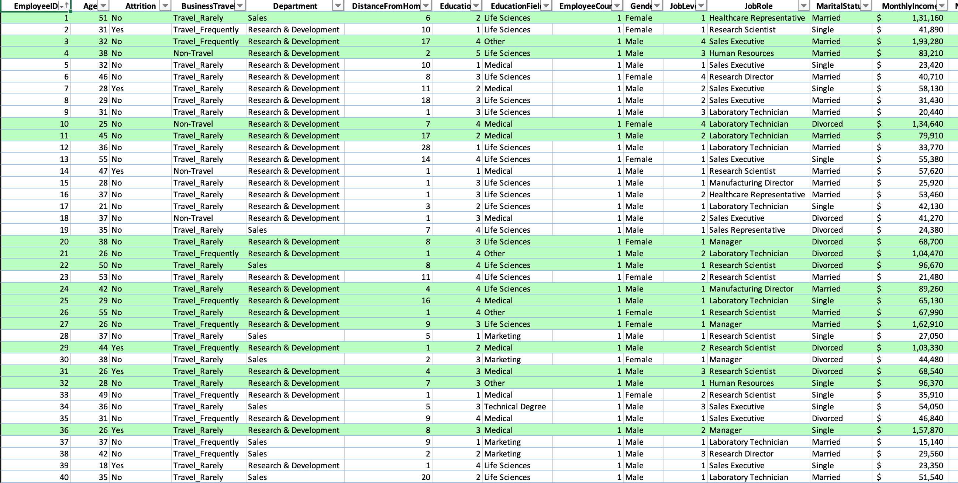
DATA QUESTIONS
3. Apply conditional formatting to highlight employees with Monthly Income above the company's average income.
Select entire dataset and choose conditional formatting
Select New rule , choose classic style, choose use formula to determine which cells to format
Enter formula = $N2 > AVERAGE($N:$N) (Monthly income column is present in column N)
1479 employees found to have monthly income greater than average monthly income.

Slide 8
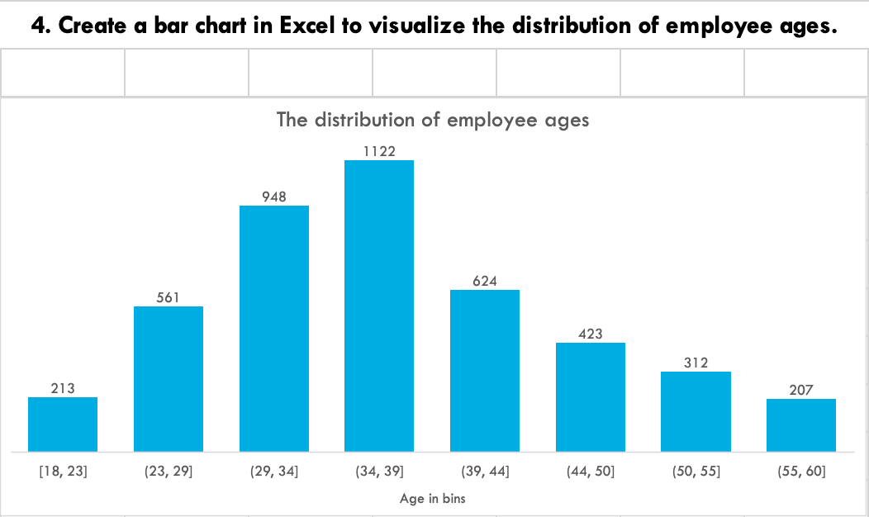
DATA QUESTIONS
4. Create a bar chart in Excel to visualize the distribution of employee ages.
Highest count of 1122 employees found to fall between the age of 34 and 39.
Lowest count of 207 employees found to fall between the age of 55 and 60.

Slide 9
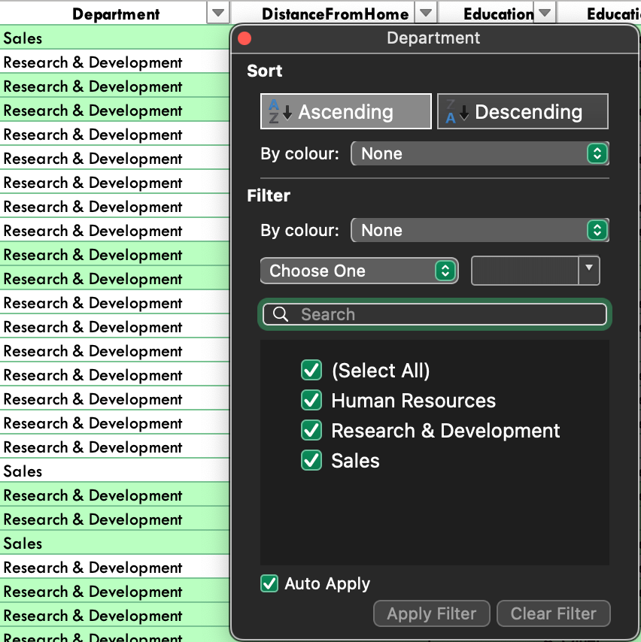
DATA QUESTIONS
5. Identify and clean any missing or inconsistent data in the "Department" column.
There are no missing or inconsistent data found in department column.
This ensures data consistency.

Slide 10
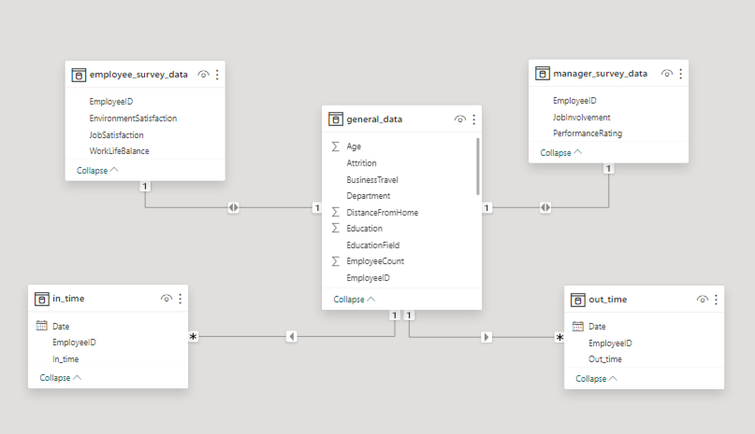
DATA QUESTIONS
6. In Power BI, establish a relationship between the "EmployeeID" in the employee data and the "EmployeeID" in the time tracking data.
Before establishing relationship, some data processing methods are applied on all available data.
Provided clear headers, removed NA columns linked to weekends/holidays, and performed unpivoting, datatype conversion, and renaming (Date, In Time, Out Time)
One – to – many cardinality.

Slide 11
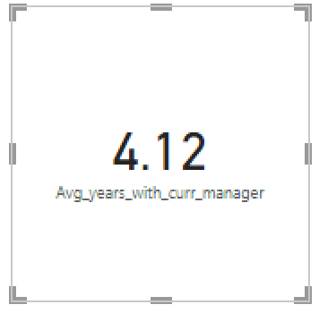
DATA QUESTIONS
7. Using DAX, create a calculated column that calculates the average years employee has spent with their current manager.
Avg_years_with_curr_manager = CALCULATE(AVERAGE(general_data [YearsWithCurrManager] ))
Average years the employee has spent with their current manager was found to be 4.12 year

Slide 12
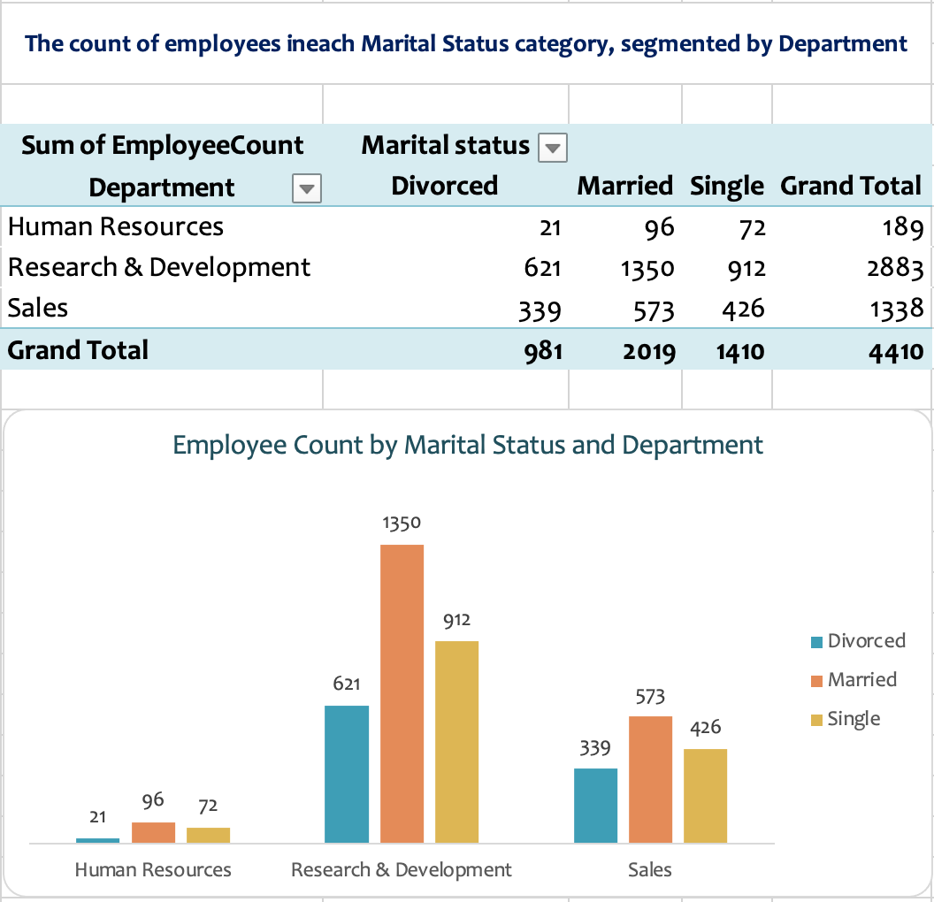
DATA QUESTIONS
8. Using Excel, create a pivotable that displays the count of employees in each Marital Status category, segmented by Department.
The highest number of employees, about 1350, is found among those who are married and belong to the Research & Development department.
In contrast, the lowest number of employees, about 21, found to be in Human Resources department and are Divorced.

Slide 13
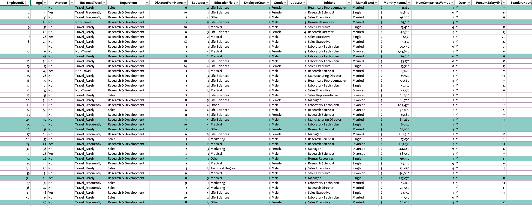
DATA QUESTIONS
9. Apply conditional formatting to highlight employees with both above-average Monthly Income and above-average Job Satisfaction.
Select entire dataset and choose conditional formatting
Select New rule , choose classic style, choose use formula to determine which cells to format
Enter formula = AND($N2 > AVERAGE($N:$N),$Z2 > AVERAGE($Z:$Z)) (Monthly income - column N and Job satisfaction - column Z)
955 employees are found to have both monthly income and job satisfaction greater than the averages.

Slide 14
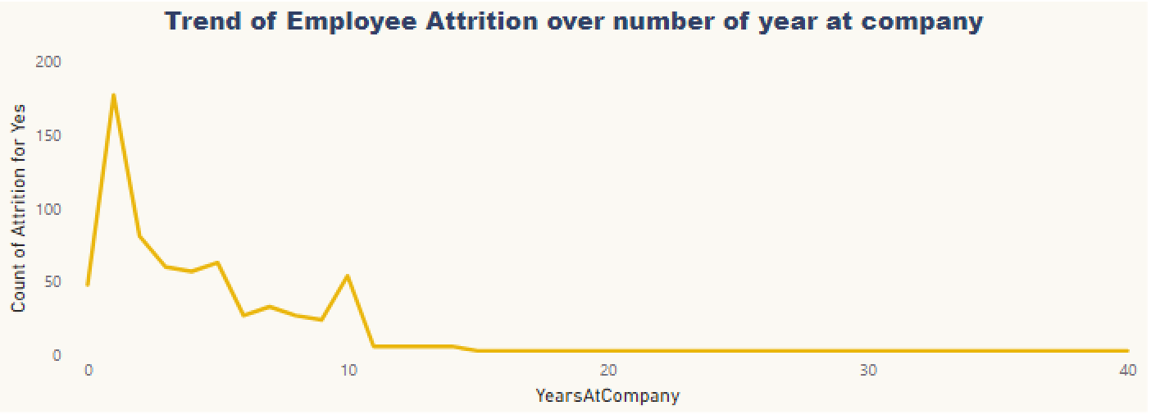
DATA QUESTIONS
10. In Power BI, create a line chart that visualizes the trend of Employee Attrition over the years at company.
Longer the employee stay in company lesser they leave and vice versa.

Slide 15
DATA QUESTIONS
11. Describe how you would create a star schema for this dataset, explaining the benefits of doing so.
A star schema design where a central fact table (General_data) with required quantitative measures is connected to multiple dimension tables (Employee_survey_data, manager_survey_data, in-time, and out-time data) through foreign key relationships. (EmployeeID)
Benefits of star schema:
Simplified data structure with easy understanding
Faster data retrieval
Effective definition of KPIs
Data consistency
Easy visualization and dashboard generation.
Star schema representation

Slide 16
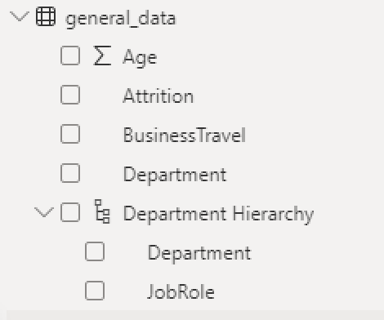
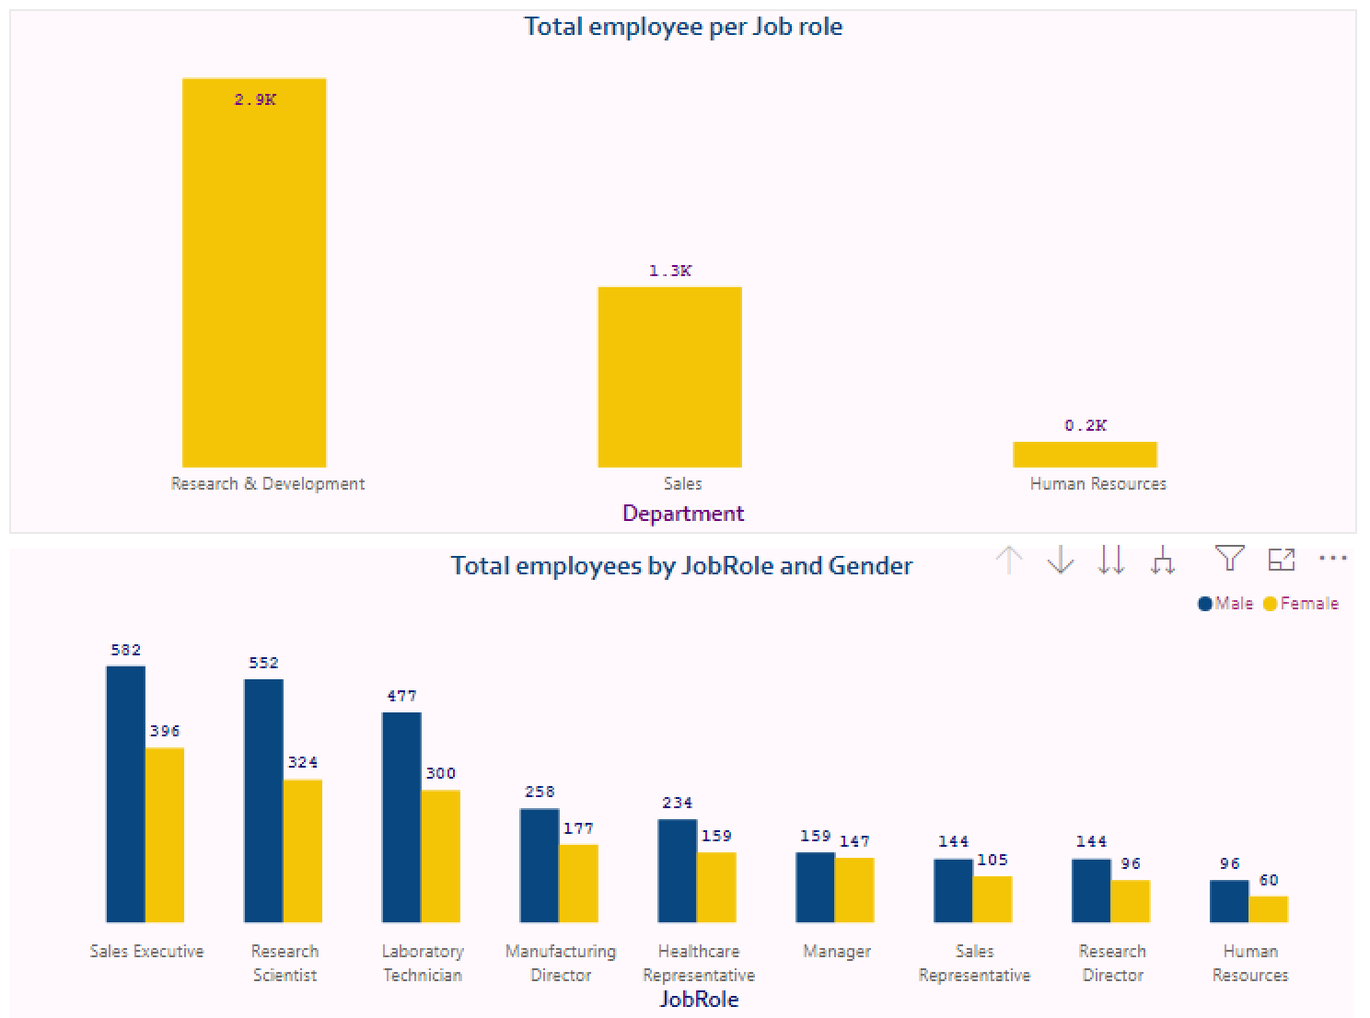
DATA QUESTIONS
12. Create a hierarchy in Power BI that allows users to drill down from Department to Job Role to further narrow their analysis.
Using hierarchies enhances the user experience in Power BI by providing a more natural way to navigate through data and gain insights at different levels of detail.

Slide 17
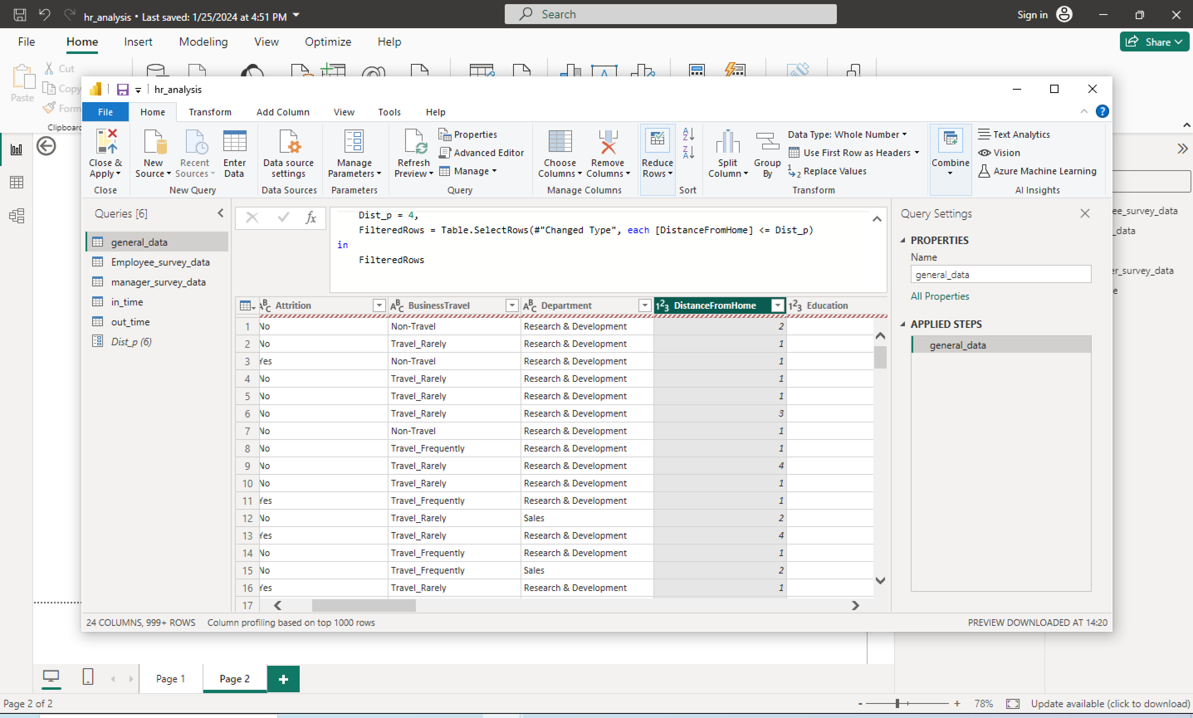
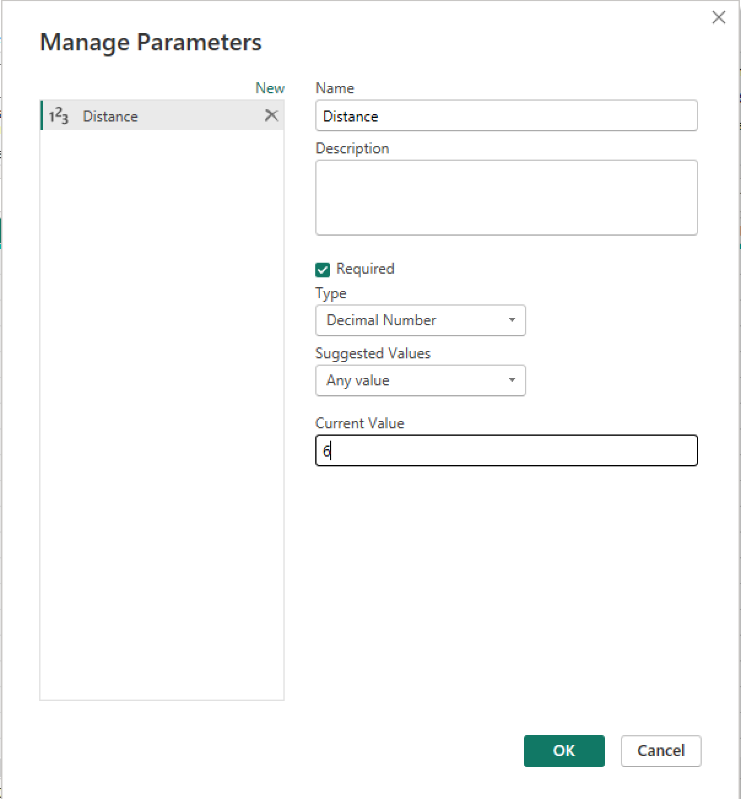
DATA QUESTIONS
13. How can you set up parameterized queries in Power BI to allow users to filter data based on the Distance from Home column?
Open power query -> Manage Parameter -> New parameter -> create parameter
Open advance editor -> add formula to filter data based on parameter created.

Slide 18
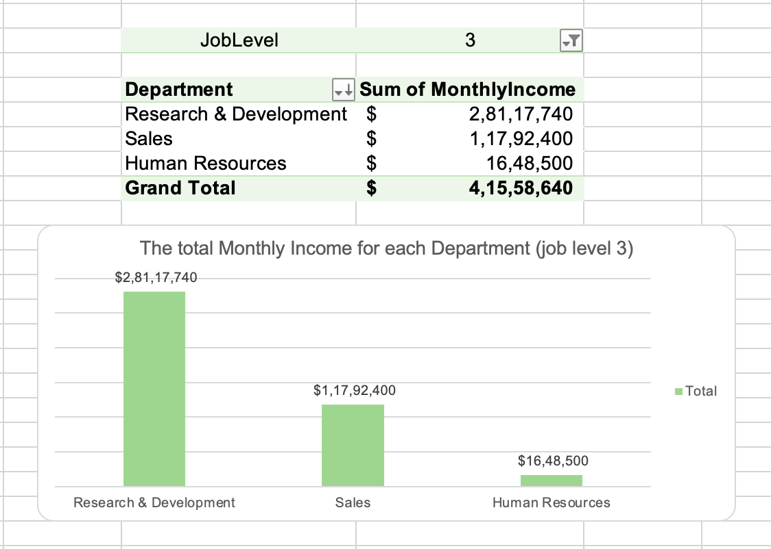
DATA QUESTIONS
14. In Excel, calculate the total Monthly Income for each Department, considering only the employees with a Job Level greater than or equal to 3.
Research & development department has the highest sum of monthly income about $2,81,17,740
Human Resources department has the lowest sum of monthly income about $ 16,48,500
The summary highlight the varying contributions of different departments to the overall Monthly Income.

Slide 19
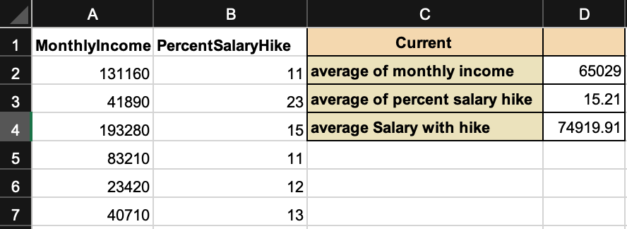
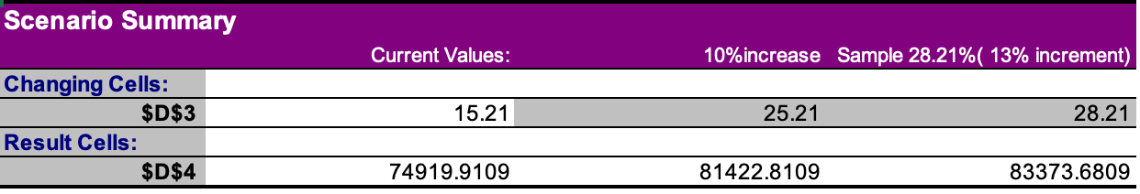
DATA QUESTIONS
15. Explain how to perform a What-If analysis in Excel to understand the impact of a 10% increase in Percent Salary Hike on Monthly Income.
Calculate averages of Monthly Income, Percent Salary Hike, and Salary with Hike. (=D2 * (1 + (D3)*0.01))
Use the Scenario Manager in What-If Analysis from the Data tab.
Add scenario for 10% increase, select changing cells to average percent salary hike.
Enter scenario values as 25.21 (15.21 + 10) and click Ok.
Create other scenarios if needed.
Click summary → Scenario summary → set result cells to cell containing the formula. (D4)

Slide 20
DATA QUESTIONS
16. Verify if the data adheres to a predefined schema. What actions would you take if you find inconsistencies?
THE PROVIDED DATA ADHERES TO PREDEFINED SCHEMA
IF INCONSISTENCIES PREVAILS
The column headers matches the expected names in Schema.
Data types in each column aligns with expected data types.
All the expected columns are present in the data.
No extra columns that are not part of predefined Schema are found
No duplicates are found in column expected to be unique (employeeID)
Verified every values in each column are valid.
would implement data validation rules to improve data integrity.
Remove or update the incorrect values which are necessary for analysis
Would delete irrelevant data from dataset and update datatype when needed.

Slide 21
DATA DASHBOARD
The following slide provides a glimpse of my dashboard.
The methods employed include the use of:
slicers
leveraging Power Query for customized results
establishing a new parameter
creating a new
implementing custom formatting for visualizations
incorporating basic DAX queries

Slide 22
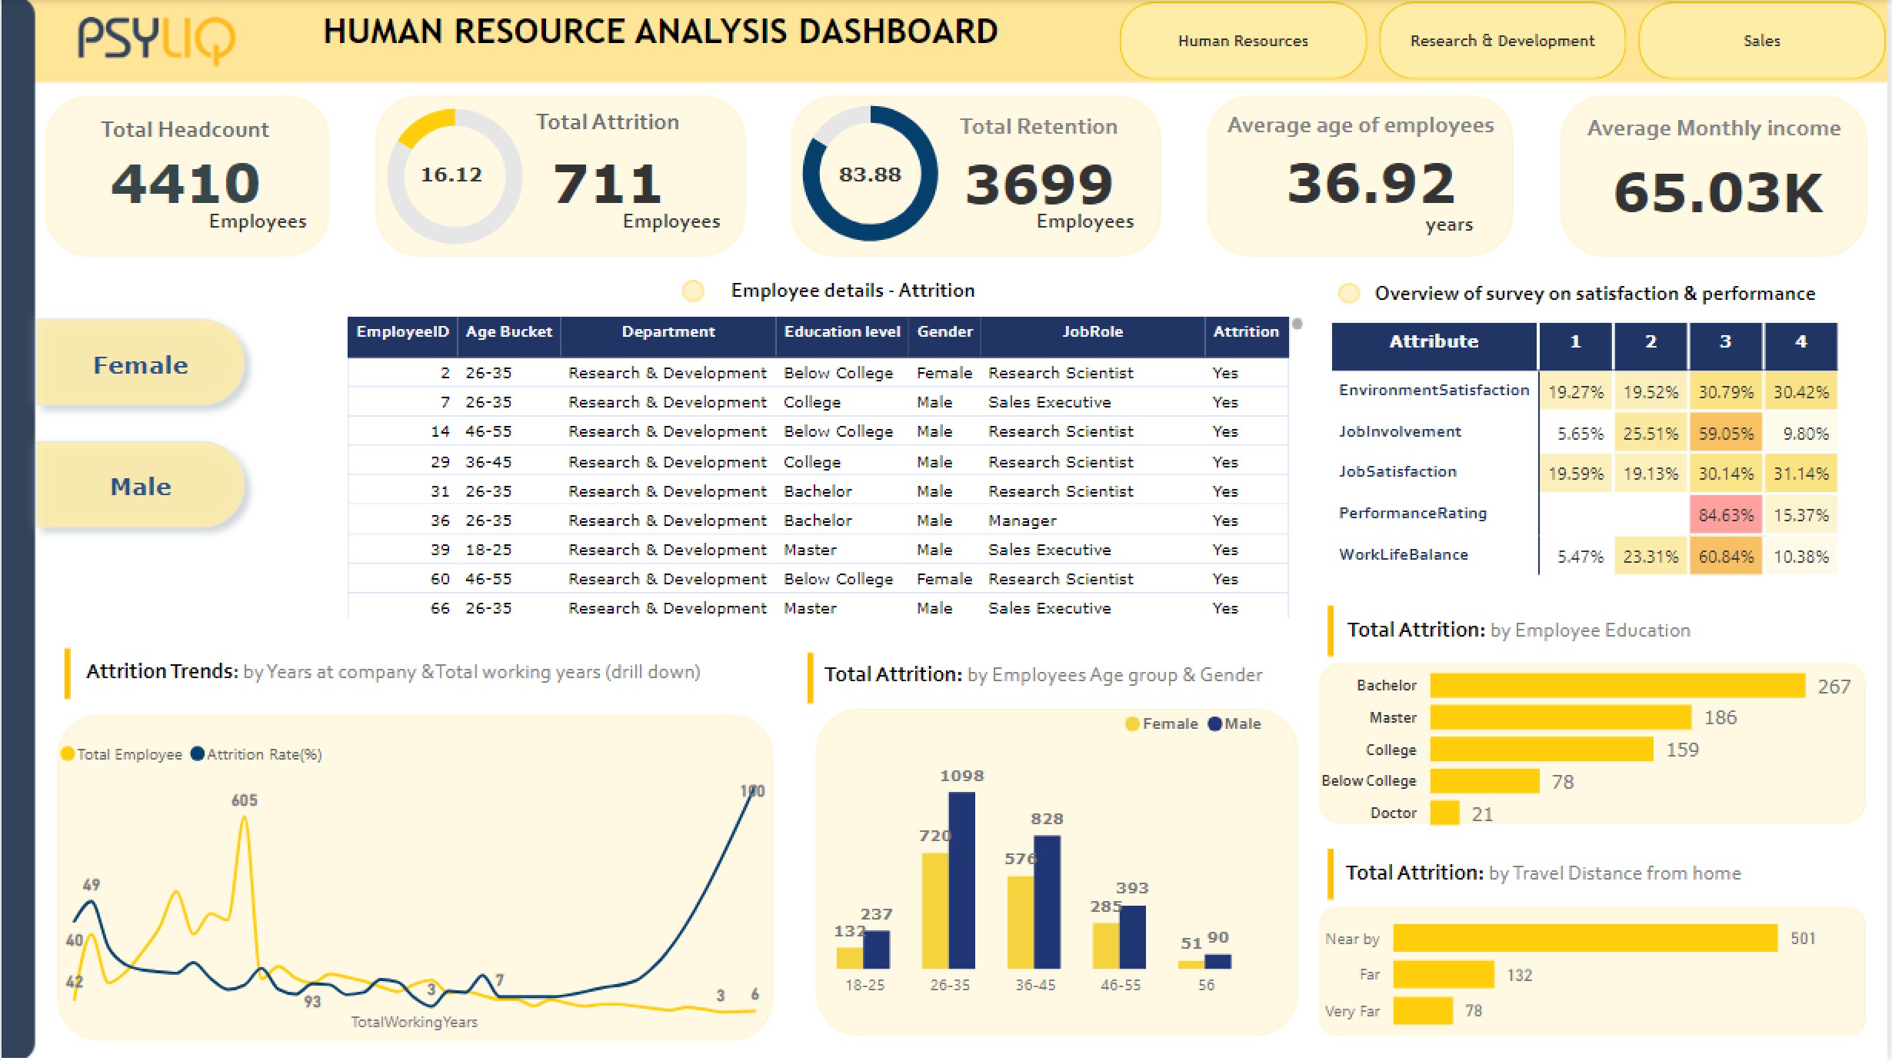

Slide 23
CONCLUSION
Of 4410 employees 711 employees (16.12%) shows attrition.
gender has a key impact on attrition, with male employees leaving at a greater rate than their female colleagues.
Employees between the ages of 26 - 35 have a significantly higher tendency to leave the organisation.
Individuals with bachelor’s degree exhibit a higher attrition rate.
About 84.3% of employees show performance rating as Excellent.
Employee with less than 10 year of total work experience tends to have higher attrition rate (49%)

Slide 24


THANK YOU
Thank you, PSYLIQ, for the invaluable opportunity for providing me with the enriching opportunity to undertake an internship focused on HR data analysis. Throughout this experience, I have had the privilege of working with essential tools such as MS-Excel and Power BI. What sets this internship apart is the acquisition of new skills, particularly in What-If Analysis, Power Query, and Power BI.

